Slide 1
Data Storage Assignment 3
Presented by- GROUP 4
Akshay Saxena 3730771
Shahin Nisha 3720296

Slide 2

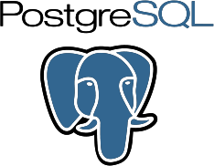

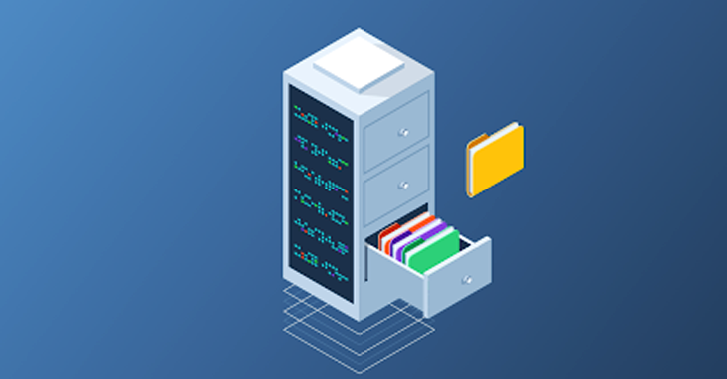
It is crucial for a company to have a secure database to protect their data from phishing and other threats. To do so the most used database in today’s market are MongoDB and PostgreSQL.

Slide 3
Main differences
MongoDB | PostgreSQL
Schema free | SQL-based but supports various NoSQL features
Document database | Relational database
Uses BSON | Uses SQL
Uses collections | Uses tables
Uses indexes | Uses joins
Uses documents to obtain data | Uses rows to obtain data

Slide 4
Both Databases Are Awesome, But What Is Your Need?
If you are looking for a distributed database for modern transactional and analytical applications that are working with rapidly changing, multi-structured data, then MongoDB is the way to go.
If a SQL database fits your needs, then Postgres is a great choice.

Slide 5
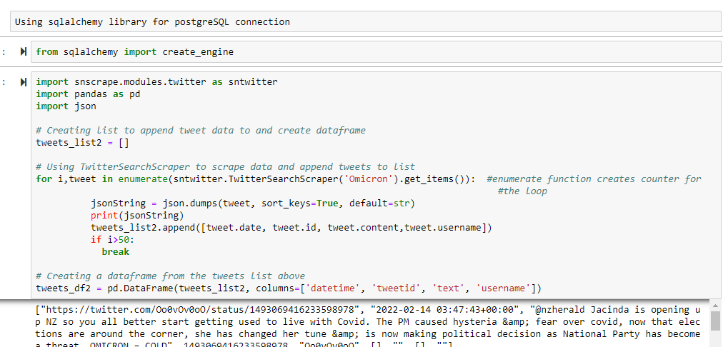
USING DQLALCHEMY LIBRARY FOR POSTGRESQL CONNECTION

Slide 6
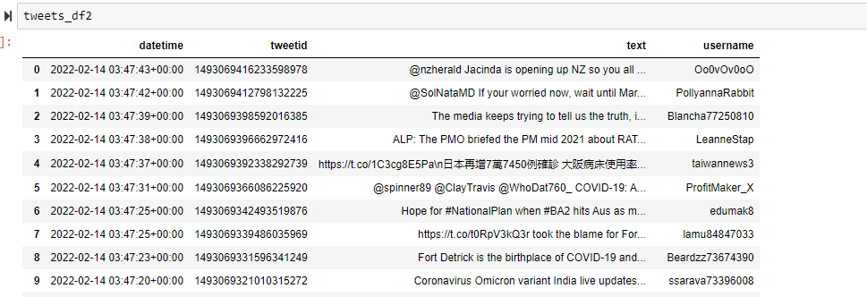
Data FRAME

Slide 7
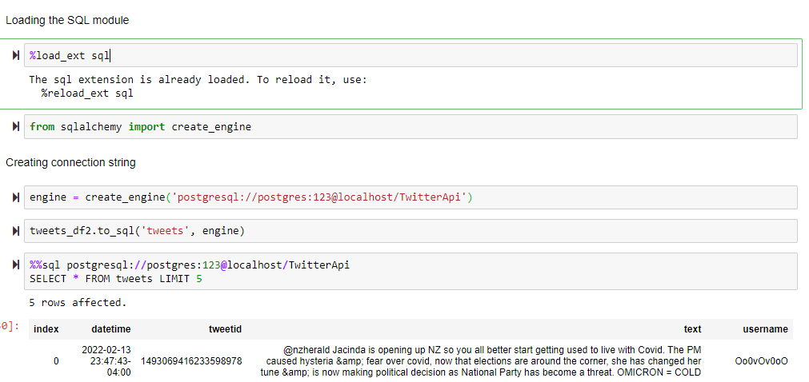
STORING DATA INTO POSTGRESQL

Slide 8
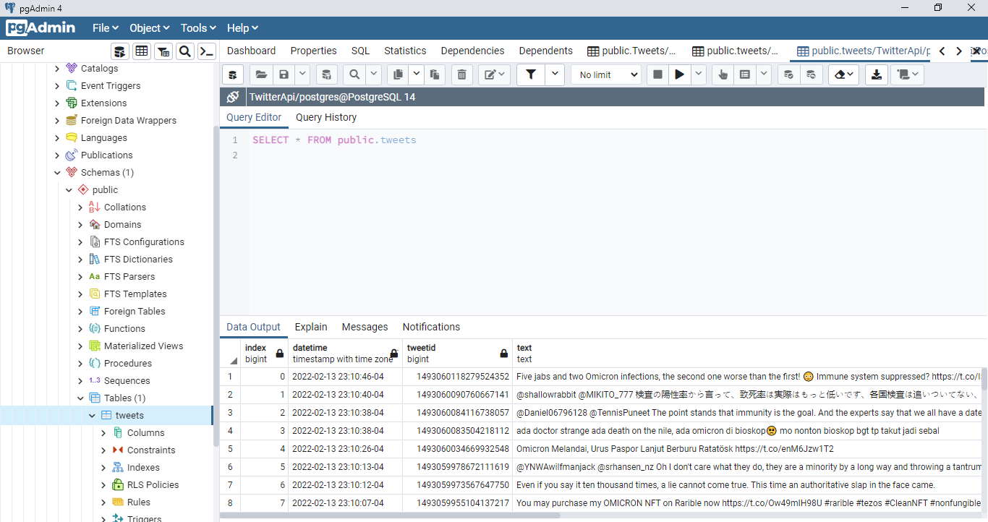
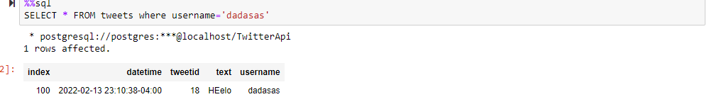
POSTGRESQL

Slide 9
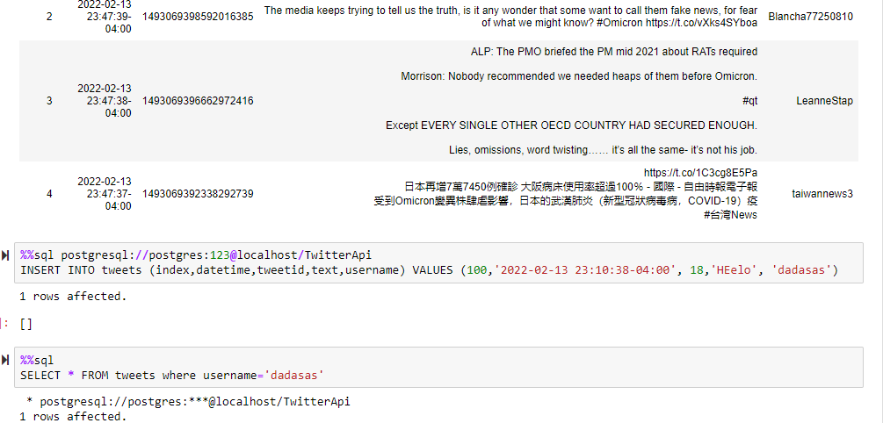
QUERYING POSTGRESQL

Slide 10
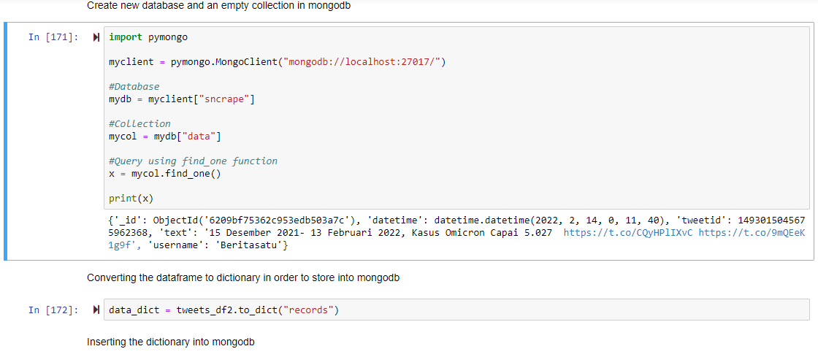
STORING DATA INTO MONGODB

Slide 11
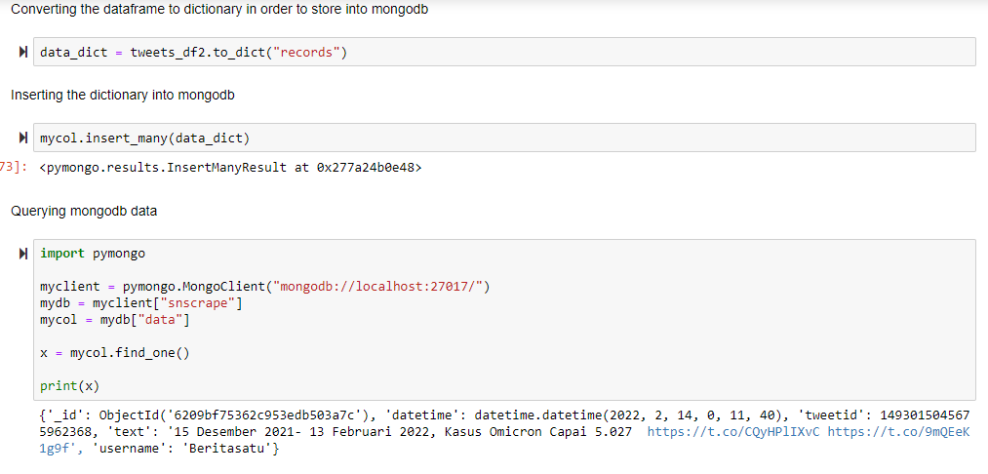
STORING DATA AND QUERYING MONGODB

Slide 12
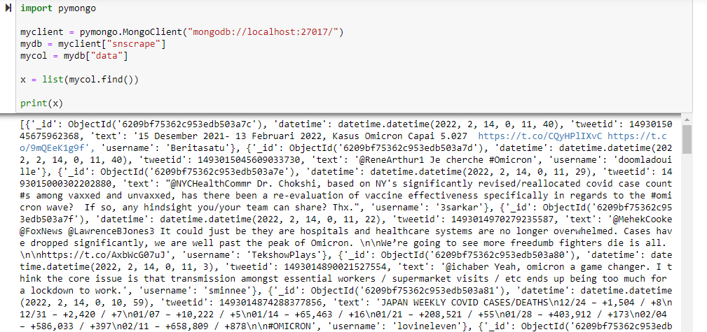
QUERYING MONGODB

Slide 13
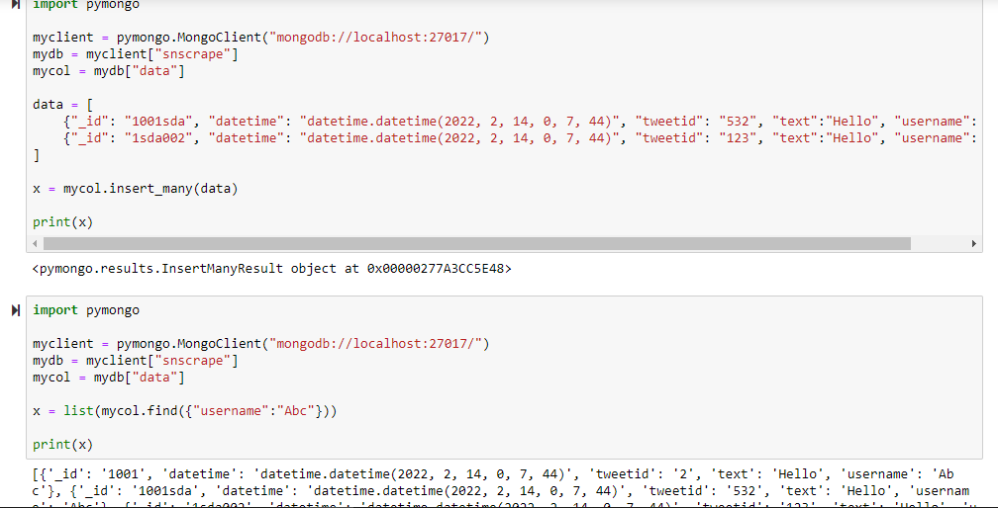
QUERYING MONGODB

Slide 14
Thank You.
Questions?

